Slide 1

Capacitated Transit Service Network Design with Boundedly Rational Agents
Presenter: Jiangtao Liu (jliu215@asu.edu)
Advisor: Dr. Xuesong Zhou (xzhou74@asu.edu)
School of Sustainable Engineering and the Built Environment
Arizona State University
Reference: Liu, J., Zhou, X., 2016. Capacitated transit service network design with boundedly rational agents. Transportation research part B 93, 225-250.

Slide 2
Outline
Introduction
Challenges and our solutions
A 0-1 integer linear programming formulation
Lagrangian decomposition for large-scale applications
Discussion
Case study
Conclusions and future research

Slide 3
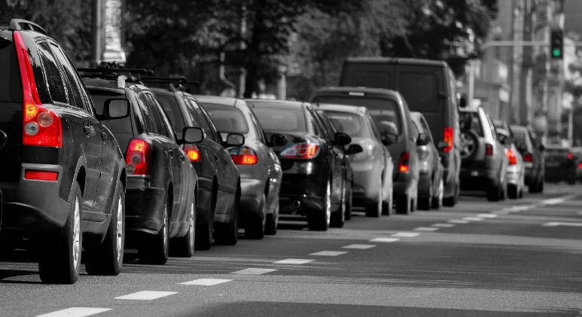

1. Introduction
Traffic at urban areas is getting worse
Congestion and Travel delay
Air pollution and Energy waste
Trip cost increase
Transit priority strategy
Ridesharing and total travel time saving
Energy consumption saving
Social equity

Slide 4
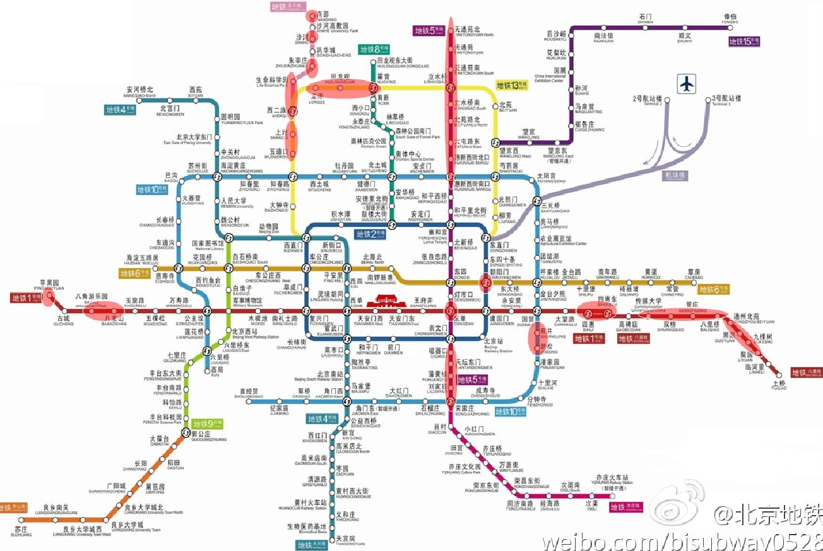
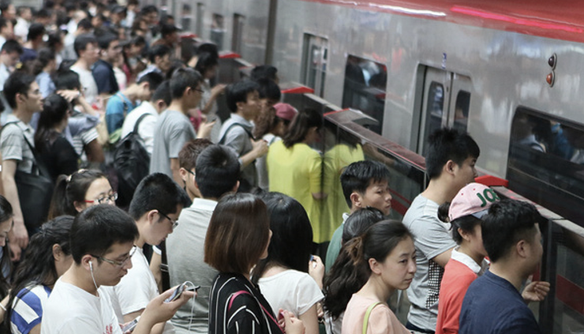
1. Introduction
In 2016 in Beijing, 75 subway stations implement “passenger inflow rate control ” policy due to its congestion during peak hours.

Slide 5
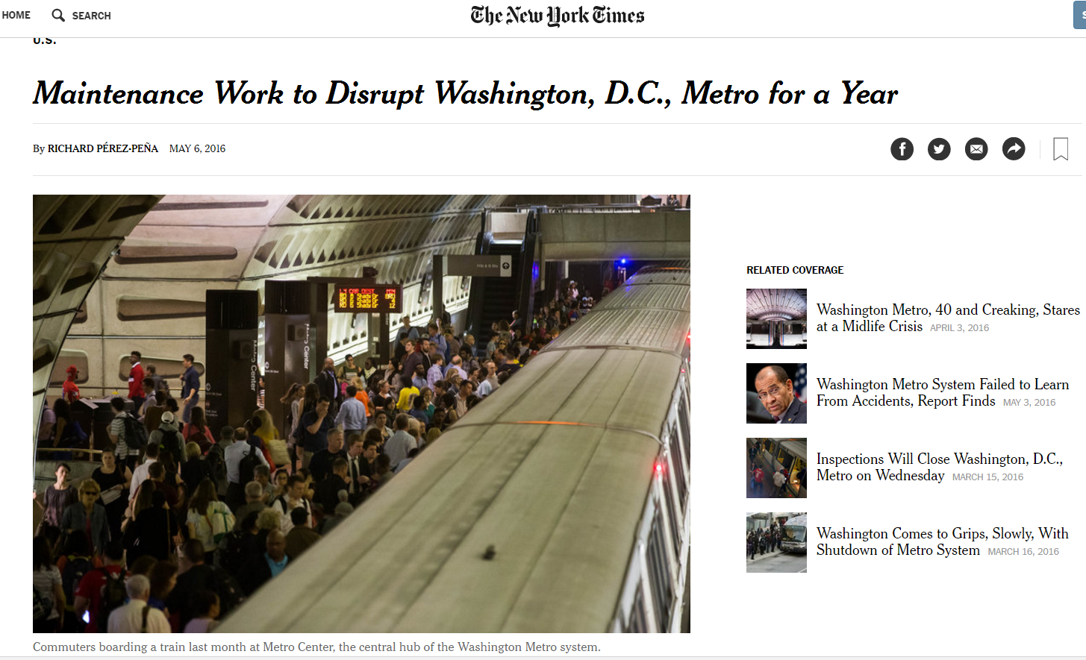
1. Introduction
Transit system could become very sensitive to any external interruption due to its congestion.

Slide 6
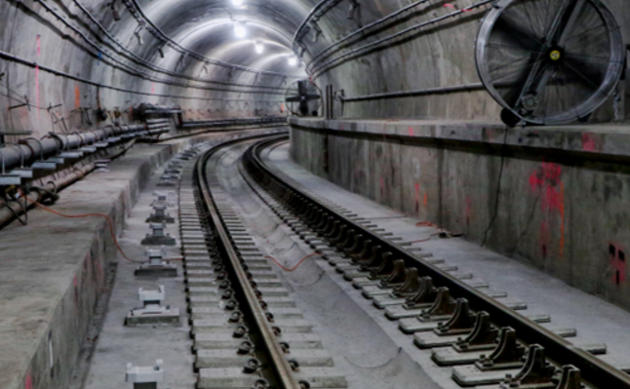
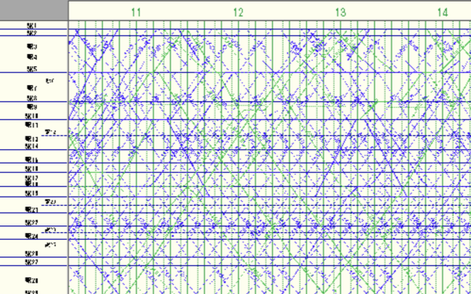
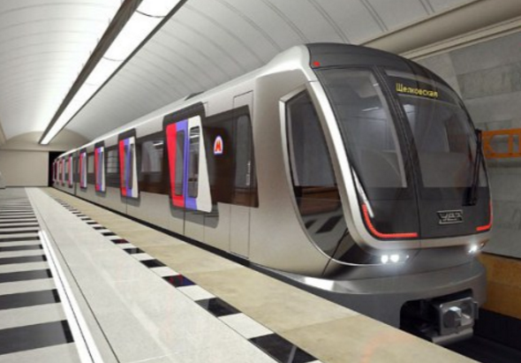
1. Introduction
Transit service network design
Open/construct a new transit line (physical line)
Add train or bus schedules or when to close a transit line for maintenance (service line)
Select different types of vehicles (service capacity)
Physical line
Schedule
Vehicle

Slide 7
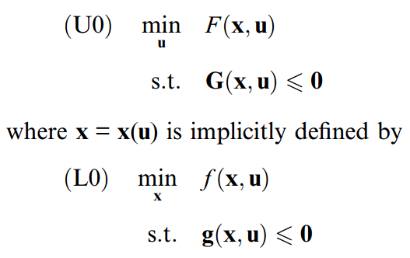
1. Introduction
How to model this problem (a bi-level programming model)?
The upper-level problem: decides where and how many lines/service arcs should be built/open to minimize the system travel cost
The lower-level problem: aims to predict travelers’ response to changes in the network conditions, by assuming certain realistic user travel behavior rules

Slide 8
1. Introduction
Existing studies | Our studies
Frequency-based static transit network design | Schedule-based dynamic transit service network design
Simplified travel behavior + tight capacity constraints (Szeto and Jiang, 2014) User equilibrium travel behavior without tight capacity constraints (Gao et al., 2004) | UE-oriented travel behavior + tight capacity constraints(e.g. vehicle carrying capacity and station spatial capacity)
Flow-based mixed integer nonlinear/linear programming problem | Agent-based integer linear programming problem

Slide 9
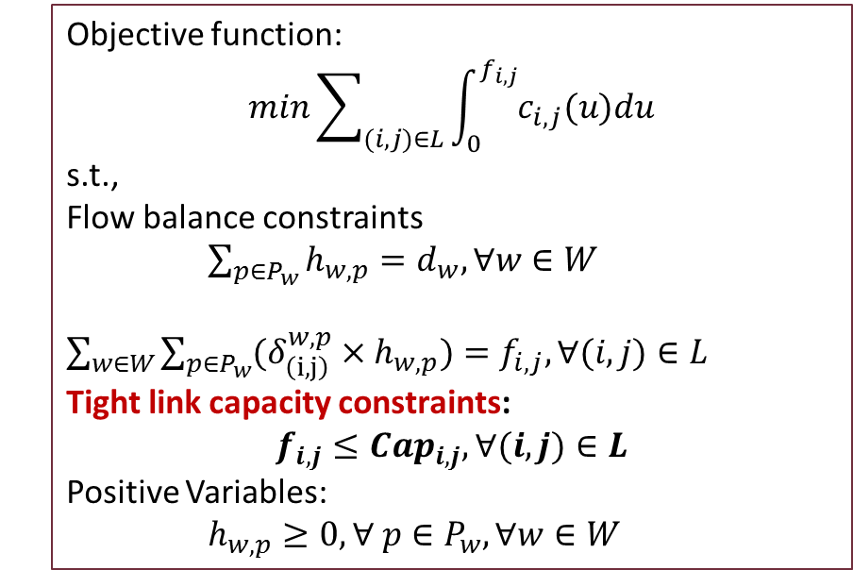
2. Challenges and our solutions
1. How to formulate the UE-oriented (Self-disutility minimization) travel behavior under tight capacity constraints?
Method 1: Modified Beckmann-McGuire-Winsten (BMW, 1956) model
Objective function:
$$min\sum_{(i,j)∈L}{\int_{0}^{f_{i,j}}{c_{i,j}(u)du}}$$
s.t.,
Flow balance constraints
$\sum_{p∈P_{w}}{h_{w,p}=d_{w},∀w}∈W$
$\sum_{w∈W}{\sum_{p∈P_{w}}{(δ_{\left(i,j\right)}^{w,p}{×h}_{w,p})=f_{i,j},∀(i,j)∈L}}$
Tight link capacity constraints:
$$f_{i,j}≤{Cap}_{i,j},∀(i,j)∈L$$
Positive Variables:
$h_{w,p}≥0, ∀ p∈P_{w}, ∀w∈W$
Hearn (1980): Wardrop’s user equilibrium may not exist
Larsson and Patriksson (1995): A generalized UE may exist where Lagrangean multipliers of link capacity constraints can be treated as link tolls
Correa et al. (2004): the solution of the modified BMW model belongs to one of Nash equilibriums in capacitated networks.
Under tight capacity/resource constraints, Nash equilibrium is not equal to Wardrop’s user equilibrium.

Slide 10
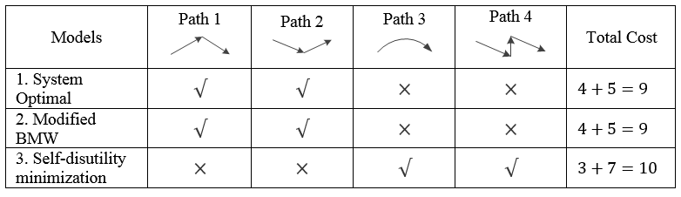
2. Challenges and our solutions
Two vehicles depart from node 1 to node 4

Slide 11
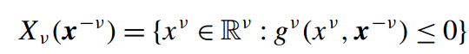
2. Challenges and our solutions
Method 2: Generalized Nash Equilibrium problems:
Where,
Continuity assumption: the objective function of each player is continuous.
For more specialized structure of particular GNEPs, it has more strict assumptions.
At present, almost no algorithm can be shown to be globally convergent under clear or reasonable assumptions (Facchinei, F., Kanzow, C., 2010)
In dynamic transit systems, the objective function of each traveler as one player is not continuous.

Slide 12
2. Challenges and our solutions
Method 3: Simulation-based dynamic transit assignment model (Poon et al., 2004;Hamdouch and Lawphongpanich, 2008;Nuzzolo et al.,2012)
The general process of simulation-based dynamic transit assignment

Slide 13
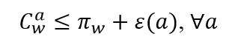
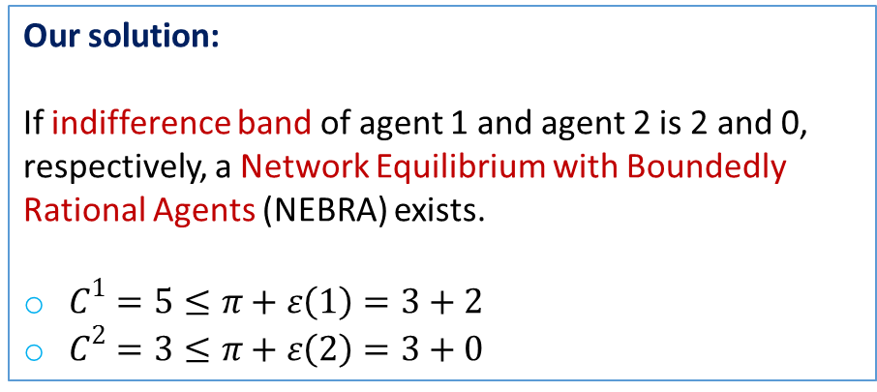
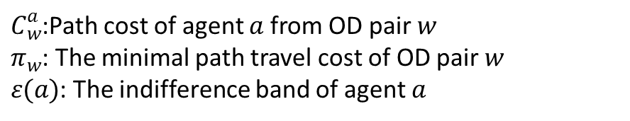
2. Challenges and our solutions
Our proposed method: Network Equilibrium with Boundedly Rational Agents
Our solution:
If indifference band of agent 1 and agent 2 is 2 and 0, respectively, a Network Equilibrium with Boundedly Rational Agents (NEBRA) exists.
$C^{1}=5≤π+ε\left(1\right)=3+2$
$C^{2}=3≤π+ε\left(2\right)=3+0$
Agent-based boundedly rational travel behavior:
Unique solution:
Path cost of agent 1 is 5;
Path cost of agent 2 is 3.
Wardrop’s UE cannot be satisfied.
$C_{w}^{a}$:Path cost of agent $a$ from OD pair $w$
$π_{w}$: The minimal path travel cost of OD pair $w$
$ε(a)$: The indifference band of agent $a$

Slide 14
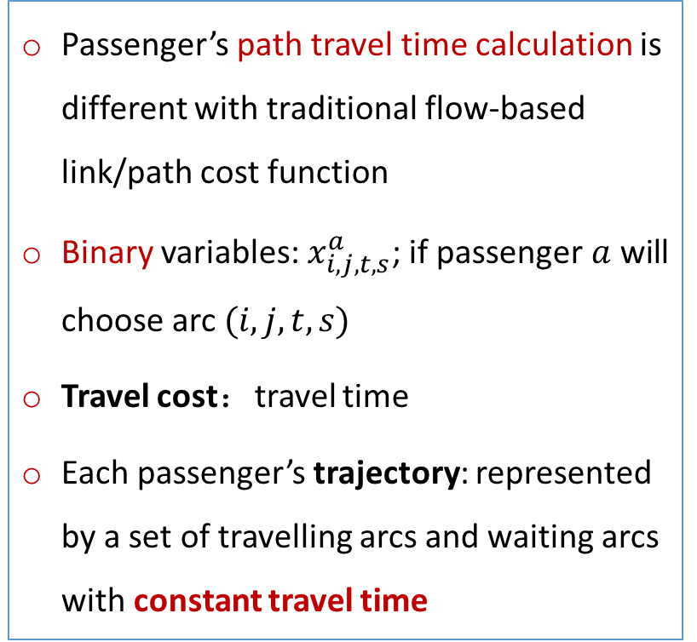
2. Challenges and our solutions
2. How to model the interactions among passengers under tight capacity constraints in transit systems?
Passenger’s path travel time calculation is different with traditional flow-based link/path cost function
Binary variables: $x_{i,j,t,s}^{a}$; if passenger $a$ will choose arc$(i,j,t,s)$
Travel cost：travel time
Each passenger’s trajectory: represented by a set of travelling arcs and waiting arcs with constant travel time
In the Space-time network, vetex $(i,t)$, arc $\left(i,j,t,s\right)$

Slide 15
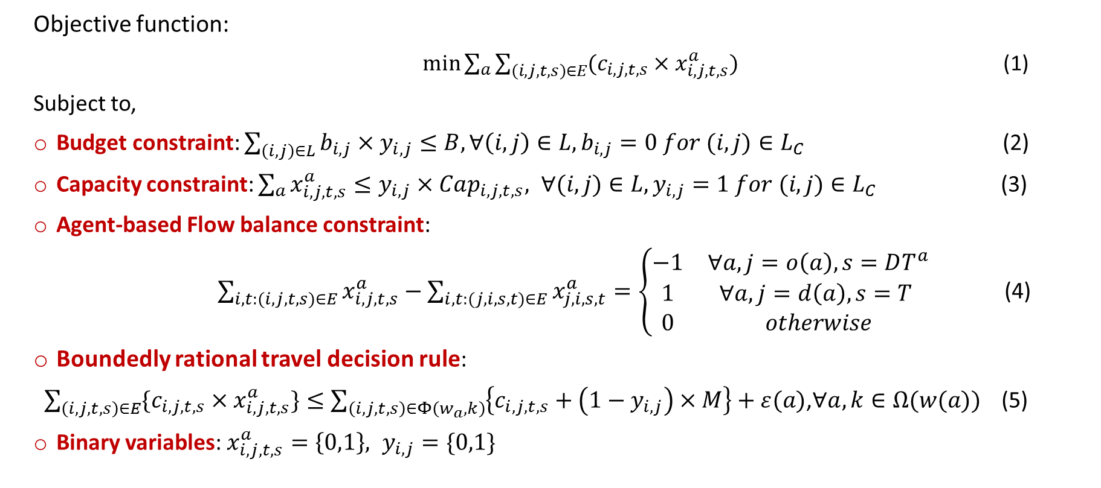
3. Our proposed mathematical formulation
Objective function:
$\min{\sum_{a}{\sum_{\left(i,j,t,s\right)∈E}{(c_{i,j,t,s}×x_{i,j,t,s}^{a})}}}$ (1)
Subject to,
Budget constraint: $\sum_{\left(i,j\right)∈L}{b_{i,j}×y_{i,j}≤B, ∀\left(i,j\right)∈L,b_{i,j}=0 for (i,j)∈L_{C}}$ (2)
Capacity constraint: $\sum_{a}{x_{i,j,t,s}^{a}}≤y_{i,j}×Cap_{i,j,t,s}, ∀(i,j)∈L,y_{i,j}=1 for (i,j)∈L_{C}$ (3)
Agent-based Flow balance constraint:
$\sum_{i,t:(i,j,t,s)∈E}{x_{i,j,t,s}^{a}}−\sum_{i,t:(j,i,s,t)∈E}{x_{j,i,s,t}^{a}}=\left\{\begin{matrix}−1 & ∀a,j=o\left(a\right),s=DT^{a} \\ 1 & ∀a,j=d\left(a\right),s=T \\ 0 & otherwise\end{matrix}\right.$ (4)
Boundedly rational travel decision rule:
$\sum_{\left(i,j,t,s\right)∈E}{\{c_{i,j,t,s}×x_{i,j,t,s}^{a}\}}≤\sum_{\left(i,j,t,s\right)∈Φ\left(w_{a},k\right)}{\left\{c_{i,j,t,s}+\left(1−y_{i,j}\right)×M\right\}}+ε(a)$,$∀a,k∈Ω(w(a))$ (5)
Binary variables: $x_{i,j,t,s}^{a}=\left\{0,1\right\}, y_{i,j}=\{0,1\}$
Single-level 0-1 integer programming model

Slide 16
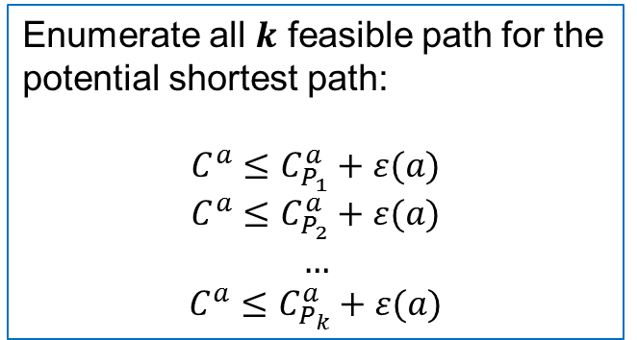
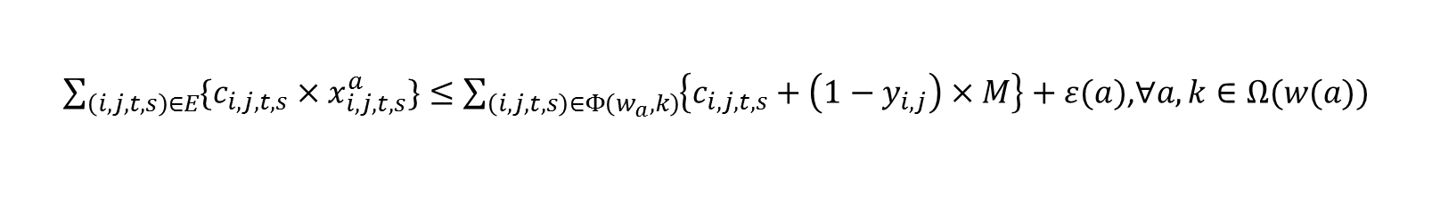
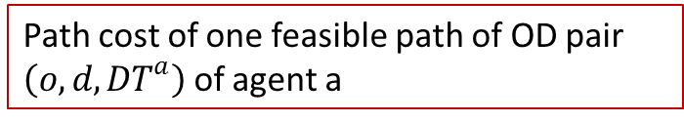
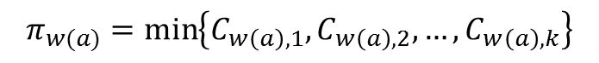
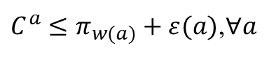
3. Our proposed mathematical formulation
Boundedly rational travel decision rule:
Enumerate all $k$ feasible path for the potential shortest path:
$$C^{a}≤C_{P_{1}}^{a}+ε(a)$$
$$C^{a}≤C_{P_{2}}^{a}+ε(a)$$
$$…$$
$$C^{a}≤C_{P_{k}}^{a}+ε(a)$$
Definition
$C^{a}≤π_{w(a)}+ε(a)$,$∀a$
$$π_{w(a)}=\min\left\{C_{w\left(a\right),1},C_{w\left(a\right),2},…,C_{w\left(a\right),k}\right\}$$
Path cost of agent a
Path cost of one feasible path of OD pair $\left(o,d,DT^{a}\right)$ of agent a
Indifference band of agent a
$\sum_{\left(i,j,t,s\right)∈E}{\{c_{i,j,t,s}×x_{i,j,t,s}^{a}\}}≤\sum_{\left(i,j,t,s\right)∈Φ\left(w_{a},k\right)}{\left\{c_{i,j,t,s}+\left(1−y_{i,j}\right)×M\right\}}+ε(a)$,$∀a,k∈Ω(w(a))$

Slide 17
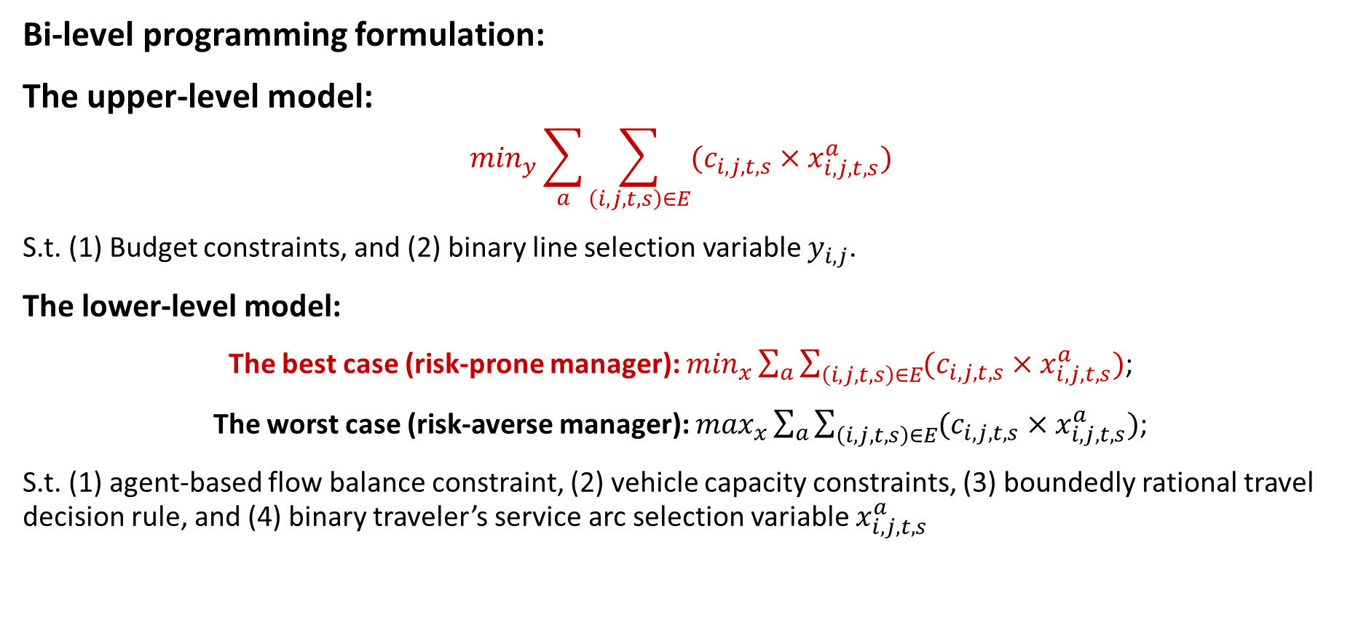
3. Our proposed mathematical formulation
Bi-level programming formulation:
The upper-level model:
$$\min_{y}{\sum_{a}{\sum_{\left(i,j,t,s\right)∈E}{(c_{i,j,t,s}×x_{i,j,t,s}^{a})}}}$$
S.t. (1) Budget constraints, and (2) binary line selection variable $y_{i,j}$.
The lower-level model:
The best case (risk-prone manager): $\min_{x}{\sum_{a}{\sum_{\left(i,j,t,s\right)∈E}{(c_{i,j,t,s}×x_{i,j,t,s}^{a})}}}$;
The worst case (risk-averse manager): $\max_{x}{\sum_{a}{\sum_{\left(i,j,t,s\right)∈E}{(c_{i,j,t,s}×x_{i,j,t,s}^{a})}}}$;
S.t. (1) agent-based flow balance constraint, (2) vehicle capacity constraints, (3) boundedly rational travel decision rule, and (4) binary traveler’s service arc selection variable $x_{i,j,t,s}^{a}$

Slide 18
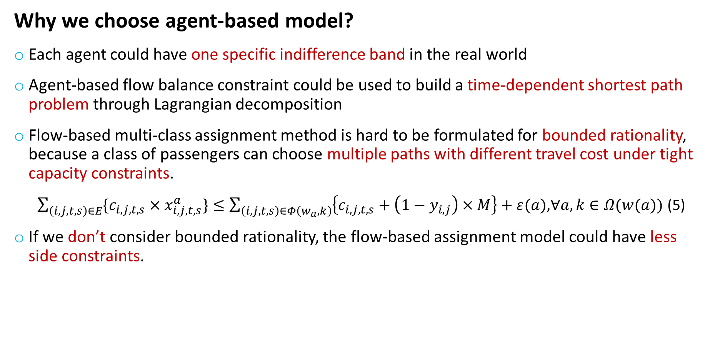
3. Our proposed mathematical formulation
Why we choose agent-based model?
Each agent could have one specific indifference band in the real world
Agent-based flow balance constraint could be used to build a time-dependent shortest path problem through Lagrangian decomposition
Flow-based multi-class assignment method is hard to be formulated for bounded rationality, because a class of passengers can choose multiple paths with different travel cost under tight capacity constraints.
$\sum_{\left(i,j,t,s\right)∈E}{\{c_{i,j,t,s}×x_{i,j,t,s}^{a}\}}≤\sum_{\left(i,j,t,s\right)∈Φ\left(w_{a},k\right)}{\left\{c_{i,j,t,s}+\left(1−y_{i,j}\right)×M\right\}}+ε(a)$,$∀a,k∈Ω(w(a))$ (5)
If we don’t consider bounded rationality, the flow-based assignment model could have less side constraints.

Slide 19
4. Our proposed algorithm

Slide 20
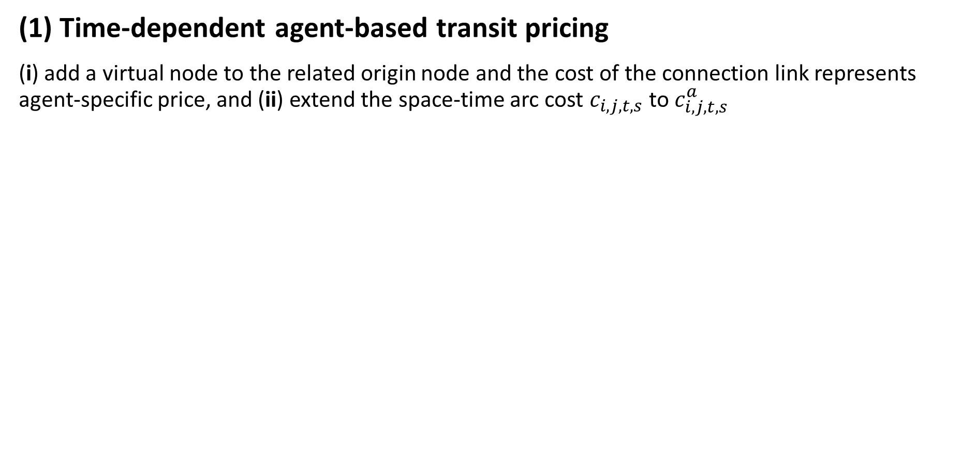
5. Discussions
(1) Time-dependent agent-based transit pricing
(i) add a virtual node to the related origin node and the cost of the connection link represents agent-specific price, and (ii) extend the space-time arc cost $c_{i,j,t,s}$to $c_{i,j,t,s}^{a}$

Slide 21
5. Discussion
(2) Passenger inflow rate control to transit stations
(i) Add a virtual node to the related origin node and (ii) define the capacity of the connection link is the permitted passenger inflow rate

Slide 22
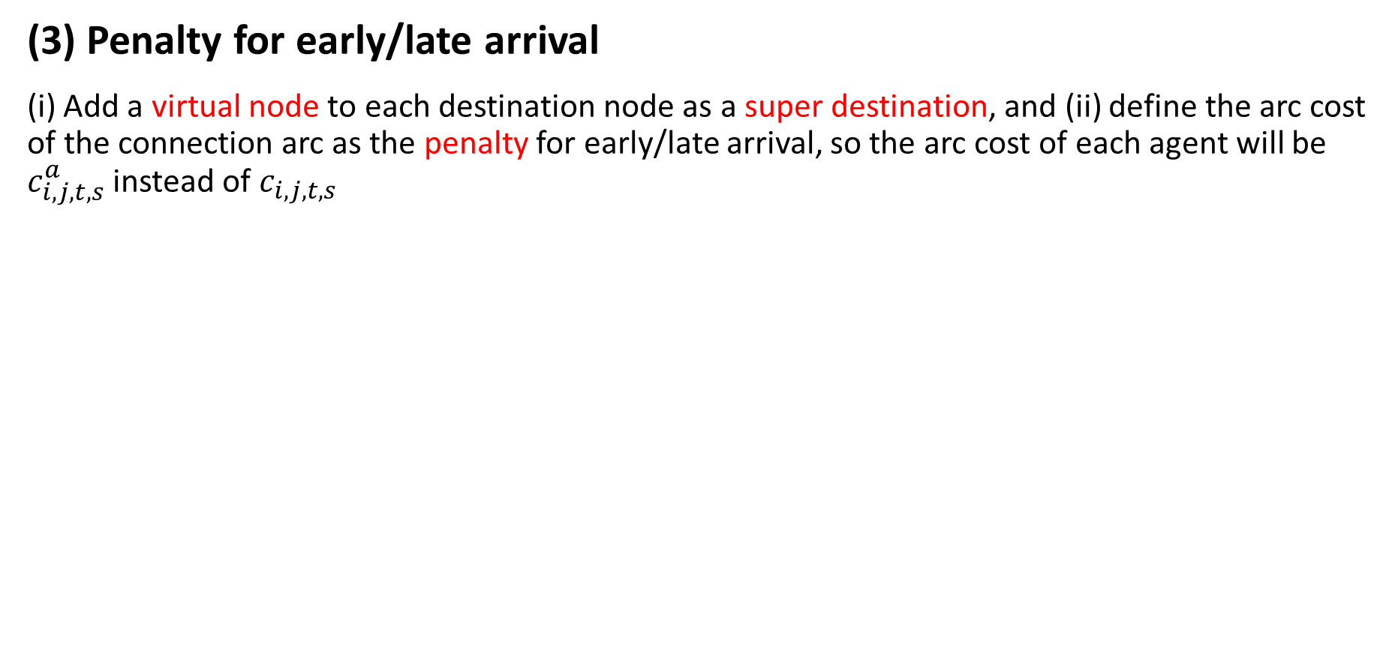
5. Discussion
(3) Penalty for early/late arrival
(i) Add a virtual node to each destination node as a super destination, and (ii) define the arc cost of the connection arc as the penalty for early/late arrival, so the arc cost of each agent will be $c_{i,j,t,s}^{a}$ instead of $c_{i,j,t,s}$

Slide 23
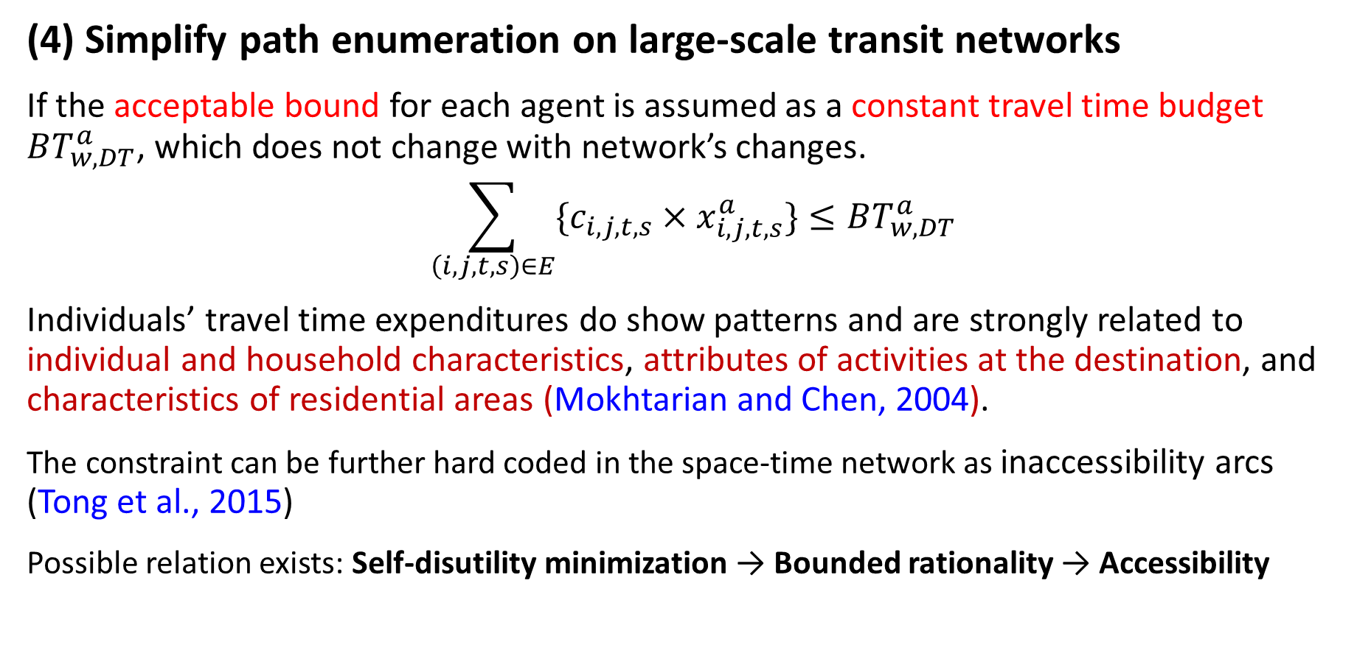
5. Discussion
(4) Simplify path enumeration on large-scale transit networks
If the acceptable bound for each agent is assumed as a constant travel time budget $BT_{w,DT}^{a}$, which does not change with network’s changes.
$$\sum_{\left(i,j,t,s\right)∈E}{\{c_{i,j,t,s}×x_{i,j,t,s}^{a}\}}≤BT_{w,DT}^{a}$$
Individuals’ travel time expenditures do show patterns and are strongly related to individual and household characteristics, attributes of activities at the destination, and characteristics of residential areas (Mokhtarian and Chen, 2004).
The constraint can be further hard coded in the space-time network as inaccessibility arcs (Tong et al., 2015)
Possible relation exists: Self-disutility minimization → Bounded rationality → Accessibility

Slide 24
5. Discussion
(5) Extension to dynamic discrete traffic (service) network design
Build new roads
Dynamic pricing
Signal optimization (System optimal, Li et al., 2015)
Maintenance scheduling
Agent-based formulation for spatial queue and queue spillback in space-time networks (Li et al., 2015)

Slide 25
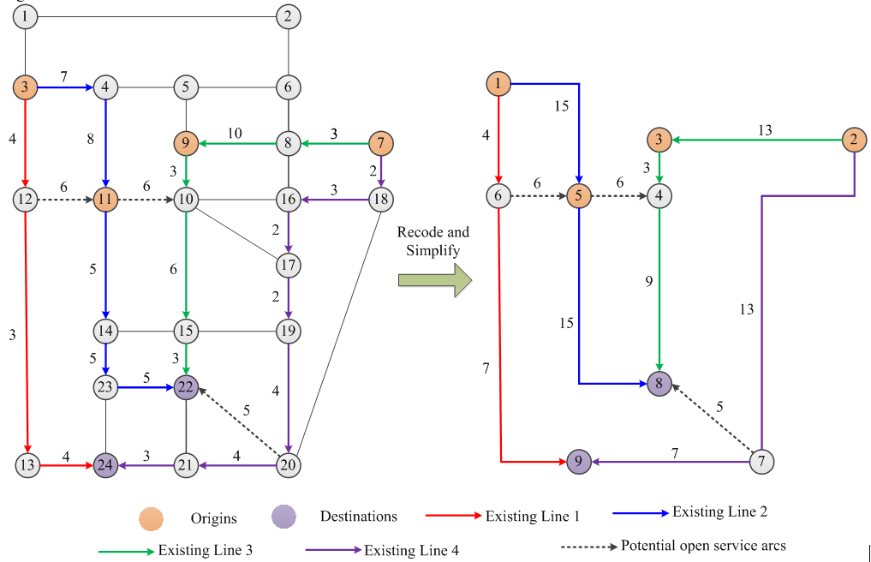
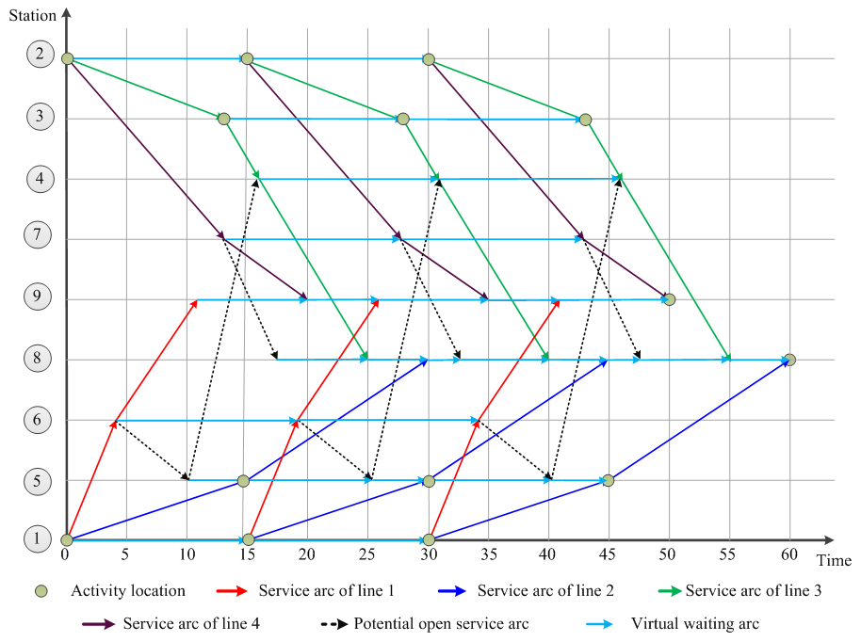
6. Case study
Physical transit network
Time-discretized space-time network
The vehicle capacity is assumed to be 20, and the indifference band for agents is 10.

Slide 26
6. Case study
Total travel time in the transit system

Slide 27
6. Case study
CPU computation time
Total demand in 1 hour
Demand Level | Total number of agents
1 | 150
2 | 180
3 | 200
4 | 800
5 | 1000

Slide 28
6. Case study
Total travel time under demand level 2 with different vehicle capacities

Slide 29
6. Case study
System performance under different indifference bands
Scenario No. | Indifference band | Total system travel time
1 | 7 | Infeasible
2 | 8 | 3500
3 | 9 | 3500
4 | 10 | 3325
5 | Specified | 3400
6 | System Optimal | 3325

Slide 30
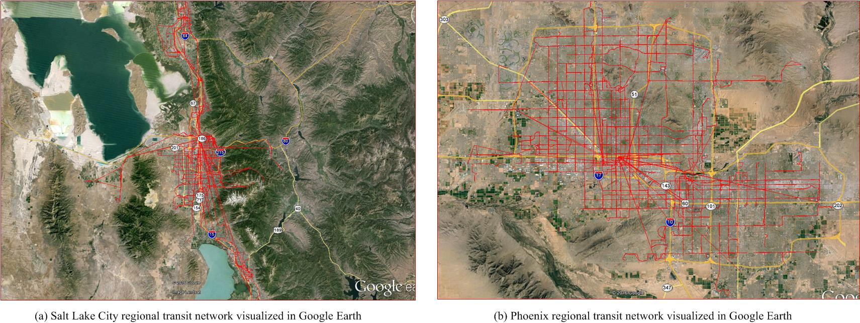
6. Case study
General Transit Feed Specification (GTFS)
Salt Lake City
Reginal area
Phoenix regional area
Networks | Demand time period | Total traffic demand | Transit demand (10%) | Computation time (1 iteration)
Salt Lake City | 15pm-18pm | 1.35 million agents | 135,000 agents | 2 min 11 seconds
Phoenix | all day (24 hours) | 10.5 million agents | 1.05 million agents | 12 min 30 seconds
Workstation：Dell Precision T7610 Workstation with 20 CPU cores and 192G RAM

Slide 31
7. Conclusion and future research
Conclusion:
Tight capacity/resource constraints can invoke the boundedly rational travel behavior
Through using a space-time network representation, each traveler’s trajectory can be represented by a set of travelling arcs and waiting arcs with constant travel times, avoiding the use of possible non-convex flow-based models in network design problems.
The network equilibrium with boundedly rational agents is not unique, and our proposed single-level 0-1 integer linear programming model just considers the best case of bounded rationality behavior.
Time-dependent transit demand, existing and potential open transit schedule, vehicle capacity, and the indifference band of each traveler, are those key components in transit service network design problems.

Slide 32
7. Conclusion and future research
Future research:
Consider the worst case of bounded rationality behavior for this kind of dynamic discrete network design problems.
Consider the limited number of transfers in transit systems
Address the responsive travel demand issue under different transit system performances
use a rich set of real world data (with impacts from tight transit capacities) to more carefully examine, calibrate and validate our model.

Slide 33
THANK YOU

